Slide 1
English Language
and English Literature
Subject Lead: Mr T Smith
t.smith@maplewell.leics.sch.uk

Slide 2
February Mock Exams - Language Paper 2 & Literature Paper 2
Language Paper 2: 1 hour 45 Minutes (2 hours 16 minutes with extra time).
Section A: Reading (40 Marks)
Four questions based around two non fiction extracts.
Question 1 (4 marks) Multiple choice.
Question 2 (8 marks) Summary.
Question 3 (12 marks) Language analysis.
Question 4 (16 marks)
Section B: Writing
One question. Non fiction creative writing task
Literature Paper 2: 2 Hours 15 Minutes (2 hours 49 Minutes with extra time).
Section A: Modern Prose or Drama (34 Marks)
One ‘either or’ question.
30 Marks + 4 AO4 marks
Section B: Anthology Poetry (30 Marks)
One comparison essay based on your chosen poetry cluster: Power and Conflict or Worlds and Lives.
Section C: Unseen Poetry (32 Marks)
A 24 mark essay based on one poem.
An 8 mark comparison question based around two poems.

Slide 3
Revision resources
Sparx Reader
CGP Books
Google Classroom
AQA Past Papers
Academic Support Program - after School Tuition, reading sessions and independent study.

Slide 4
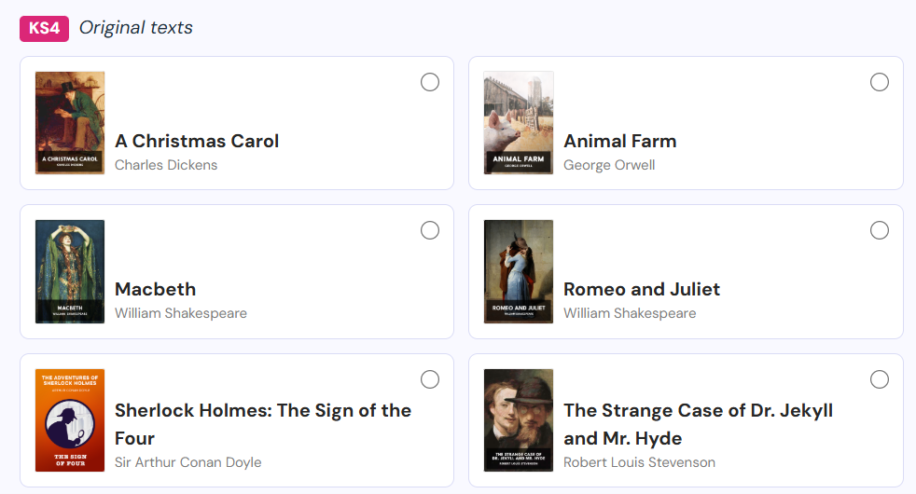
Sparx reader - set texts for literature (can now be reassigned!)

Slide 5
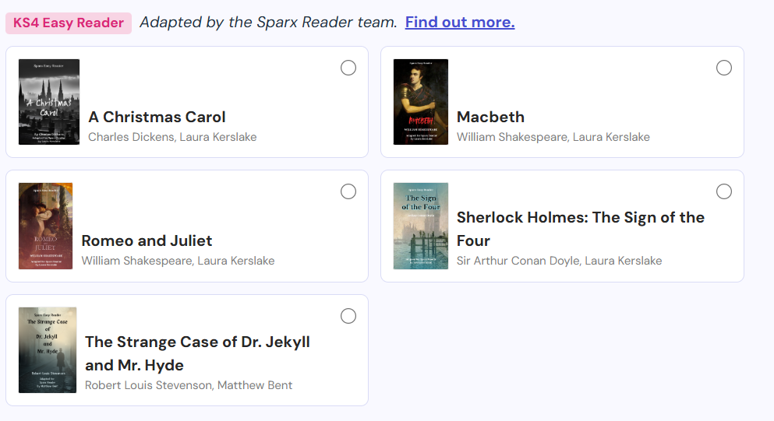

Slide 6
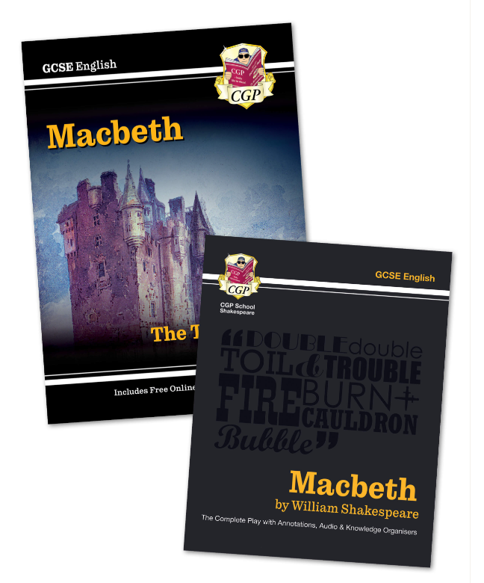
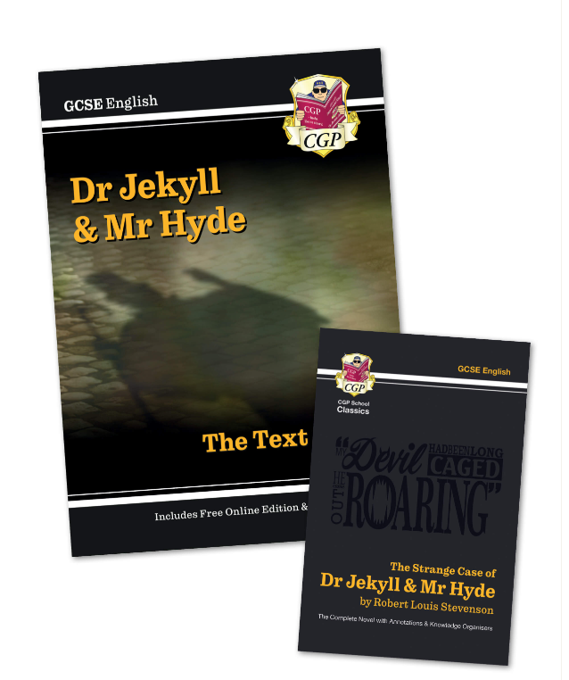
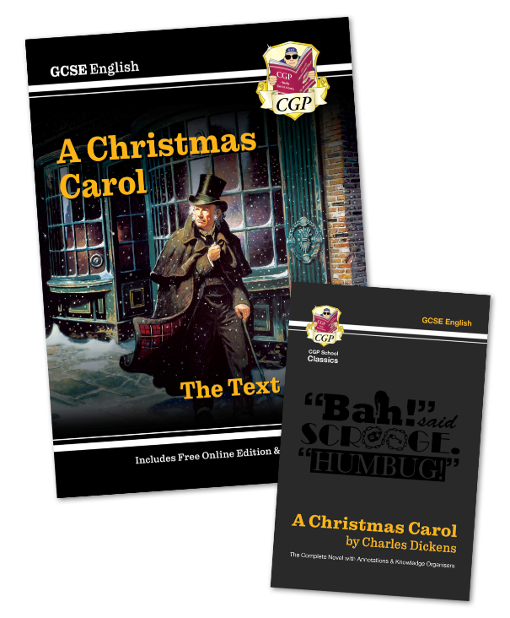
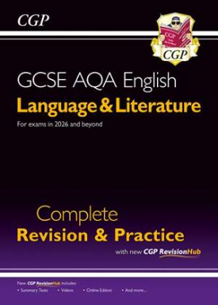
CGP Books (currently on order)

Slide 7


AQA Past Papers
https://www.aqa.org.uk/subjects/english/gcse/english-8702/assessment-resources
https://www.aqa.org.uk/subjects/english/gcse/english-8700/assessment-resources

Slide 8
Changes to English Language for 2026 exams
Key Changes for 2026 Onwards
Paper 1, Question 1: Replaced the "list four things" question with a multiple-choice format.
Paper 1, Question 3 (Structure): Now offers a specific focus (e.g., "How has the writer used structure to create mystery?") instead of a broad prompt, guiding analysis.
Paper 1, Question 4 (Critical Evaluation): Removes the "A student said..." phrasing for clearer focus and updates the methods bullet point.
Paper 1, Question 5 (Creative Writing): Clarifies that imagination is encouraged beyond the picture stimulus, allowing for story openings or broader creative ideas.

Slide 9
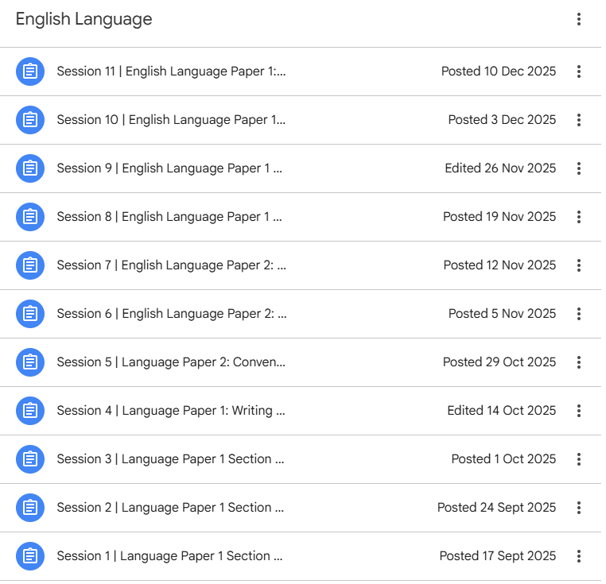
After School Tuition Classroom

Slide 10
Subject Lead: Mr T Smith
t.smith@maplewell.leics.sch.uk

