Slide 1
Mathematics
Maplewell Hall School
HoD: Miss C Greenhill
Notes:
Hello. I’m Miss Greenhill and I’m the Head of the Mathematics Department at Maplewell Hall School.
Today I’m going to talk about how your child can prepare for their Maths examinations.

Slide 2
Mock Exams:
W/C 23rd February 2026
Paper 2 – Calculator
Notes:
Students in year 11 completed paper 1 (non-calculator paper) in December. We will go on to complete mock exams in February for Maths this will be a Paper 2 (Calculator). Paper 3 possible as an in-class assessment.

Slide 3
The best way to revise maths is to practise!
Sparxmaths.uk
Corbettmaths.com
Mathsgenie.co.uk
Notes:
The best way to revise maths is to actually practise answering questions. Maths is one of those subjects where you can only get so much from reading the revision guide, students need to have a go at answering questions to ensure they can interpret the problem as well as select and apply the skills they have been studying. I’ve put up three websites on the slide where there are lots of questions across all topics that students can revise from. All of these websites have a video feature to help the students if they are unsure of a process.
According to studies, revising in small blocks frequently is the best way for students to remember what they have learned. It is important to revisit skills regularly to ensure the student can retrieve the information. As the exams get closer, gradually increase the time spent revising. Practicing exam-style questions, which are available on corbettmaths and mathsgenie, will help to make students more comfortable when they see questions of this nature in their exams.
When revising, students should aim to answer questions as they would in an exam, showing their steps of working out in order to obtain as many marks as possible.

Slide 4
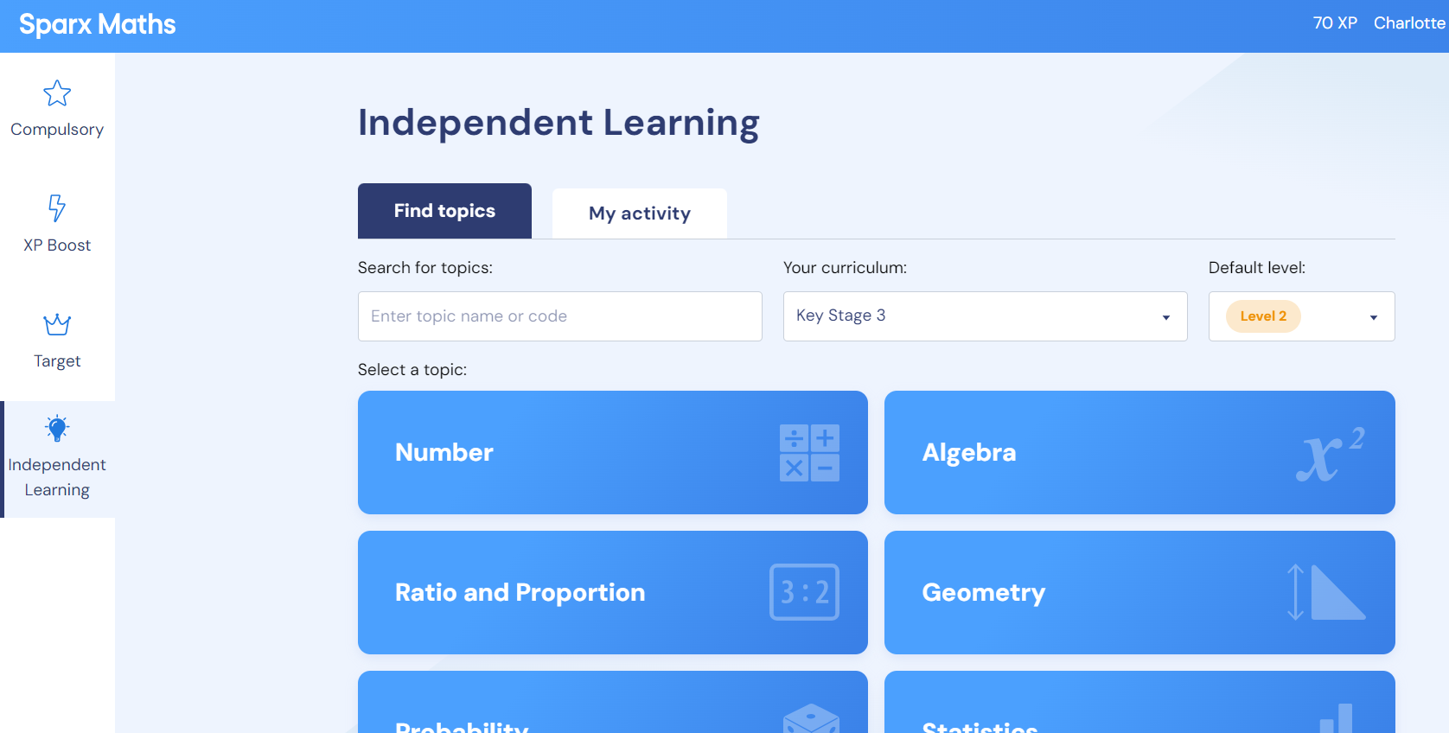
Notes:
One resource that has proved very effective for revision is Sparx Maths, which we also use to set homework.
There are hundreds of lessons available and students have access to all of them so that they can select the areas they wish to revise. If there is a particular topic that students would like to revise they can search for it in the search bar – Sparx maths will suggests the tasks along with the videos that are linked to the searched keywords.

Slide 5
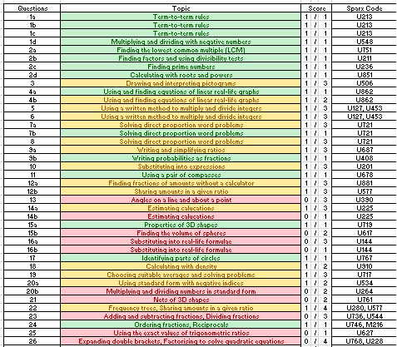
Notes:
All pupils receive 2 copies of their QLA – use for Sparx codes revision.

Slide 6

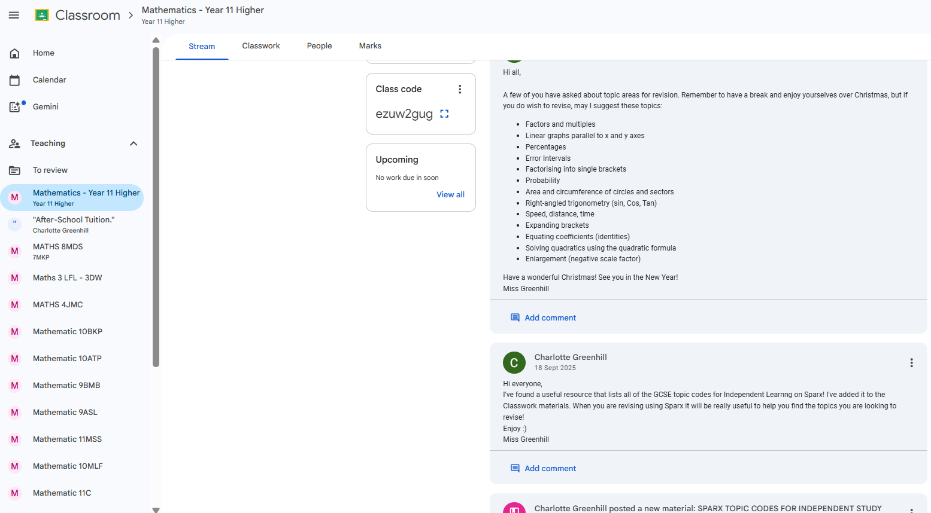
Notes:
Additionally, pupils can communicate with their teacher via Google Classroom, where useful messages and revision resources are posted.
Independent Working activities are also posted on the After School Tuition Google Classroom.

Slide 7
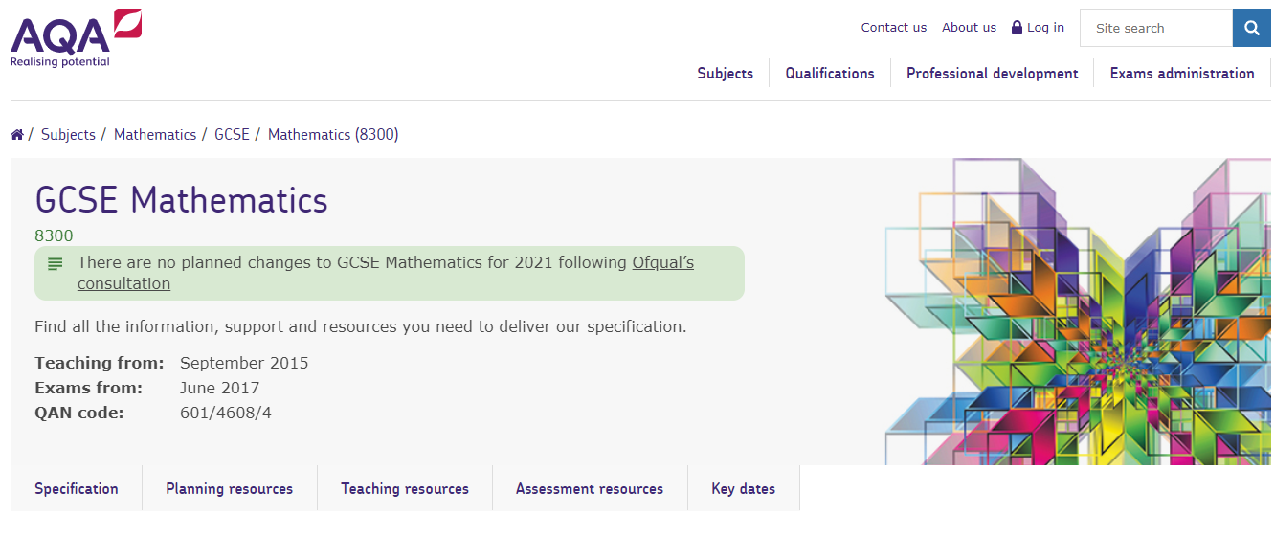
Aqa.org.uk
Notes:
We use the AQA exam board for all of the maths examinations. There is additional information on their website.
Students sitting GCSE examination will sit 3 papers, each 90 minutes duration plus any extra time that they are entitled to, one non-calculator and two calculator papers. These are all evenly weighted in terms of the number of marks available.

Slide 8
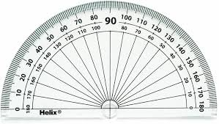
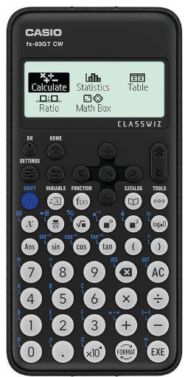
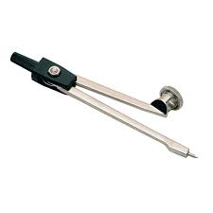
Equipment
Notes:
It is advised that where possible students have their own equipment. This way they can get used to using it and be comfortable doing so. This is particularly the case with a scientific calculator and understanding how to use it for particular calculations and functions. It is important that students feel comfortable with the equipment they are using in exams – which may be more challenging if they are borrowing equipment that is different to what they are used to.

Slide 9
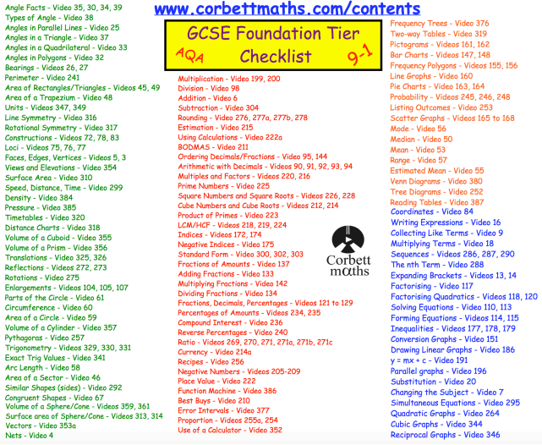
Notes:
For students sitting GCSE examinations, topic checklists are available on corbettmaths.com for both the Higher and Foundation tiers. This may be a useful resource to use when students are putting together a revision timetable.

Slide 10
Ways to revise
Engaging well in all lessons and completing daily retrieval practice.
Completing morning numeracy booklet – one page every day.
Completing homework every week. (Extend to Target and XP Boost to really improve your technical skills!)
Engaged with your weekly Maths session during Independent Study in school.
Engage with After-School Tuition online on Thursdays 4:30 – 5:30pm.
Revise independently (use the videos and activities) using one of the suggested websites.
Notes:
On the screen now are some of the ways we advise that your child revises for their maths exams.

Slide 11
c.greenhill@maplewell.leics.sch.uk
Notes:
If you require any further information about preparing for maths examinations, feel free to e-mail myself or your child’s maths teacher and we would be happy to help.

