Slide 1
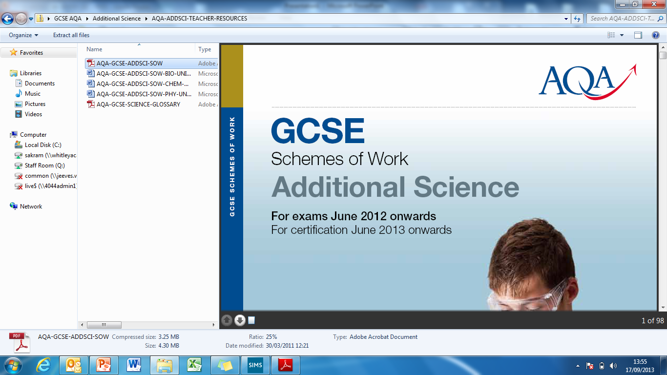
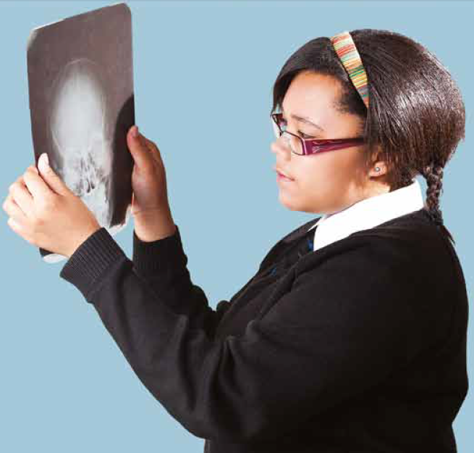
13/01/2026

Slide 2
GCSE Combined Science: Trilogy
This double award is equivalent to two GCSEs and is split over 6 exams. 2 biology, 2 chemistry and 2 physics.

Slide 3
GCSE Single Science Biology
This single award is worth one GCSE in science and is purely biology content. It is split into two exams.

Slide 4

Biology (Single included)
• Cell biology
• Organisation
• Infection and response
• Bioenergetics
• Homeostasis and response
• Inheritance, variation and evolution
• Ecology

Slide 5

Chemistry
• Atomic structure and the periodic table
• Bonding, structure, and the properties of matter
• Quantitative chemistry
• Chemical changes
• Energy changes
• The rate and extent of chemical change
• Organic chemistry
• Chemical analysis
• Chemistry of the atmosphere
• Using resources

Slide 6
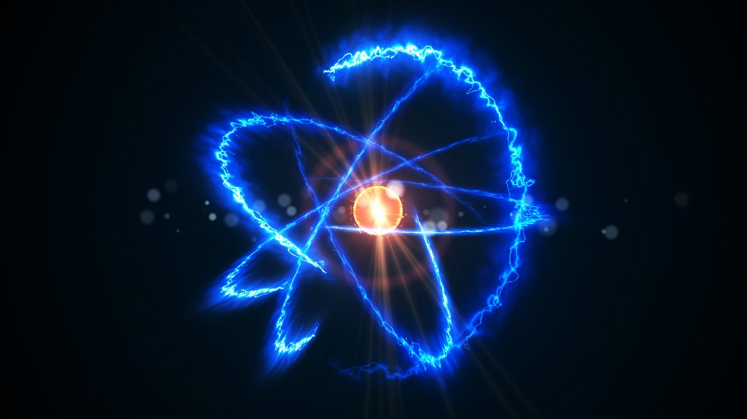
Physics
• Forces
• Energy
• Waves
• Electricity
• Magnetism and electromagnetism
• Particle model of matter
• Atomic structure

Slide 7

The best revision techniques!
https://www.youtube.com/watch?v=p60rN9JEapg

Slide 8
Effective Revision!
Should be active, that means not just reading the revision guide or knowledge organisers.
DO take notes- cover, check and repeat
DO Fill in your white science workbooks and knowledge organisers
DO make mind maps
DO colour code your notes- e.g. green for biology
DO lots of short revision sessions e.g 30 minute sessions
Do practice questions:
https://www.aqa.org.uk/subjects/science/gcse/combined-science-trilogy-8464/assessment-resources?f.Resource+type%7C6=Question+papers
Watch YouTube videos
https://www.youtube.com/c/Freesciencelessons/playlists (you will need the GCSE 9-1 playlists)

Slide 9
Sparx Learning
Sparx learning is a very effective revision tool- it’s not just for homework!
It breaks down information into manageable chunks.
I suggest doing small bursts of Sparx frequently to reinforce your learning.
Use the independent learning section for revision.

Slide 10

Important exam tips-BUG!
Box the command word of the question (by literally drawing a box around it).
Underline key words in the question which tell you what topic or theme the question relates to (e.g. whether it relates to osmosis, infection, cell structure or something else)
Glance over the question one last time before you answer it to make sure you’ve not missed any essential information.

Slide 11
Important exam tips
READ THE QUESTION! Do NOT skip over parts of a question or you could miss what it is asking.
Look at how many marks it is worth. If it is 1 mark do NOT spend lots of time on it!
For 6 mark questions, make a plan before answering the question- this could be a small mind map on a spare piece of paper.

Slide 12
On the day of the exam, mocks and real ones!
Students must have a clear pencil case with:
  a couple of sharp pencils
  A rubber
  A couple of black pens
  A ruler
  A calculator
  A protractor
  Optional but useful- a highlighter for highlighting information in questions

Slide 13
Any questions or problems, please email me:
s.comerford@maplewell.leics.sch.uk

