Slide 1
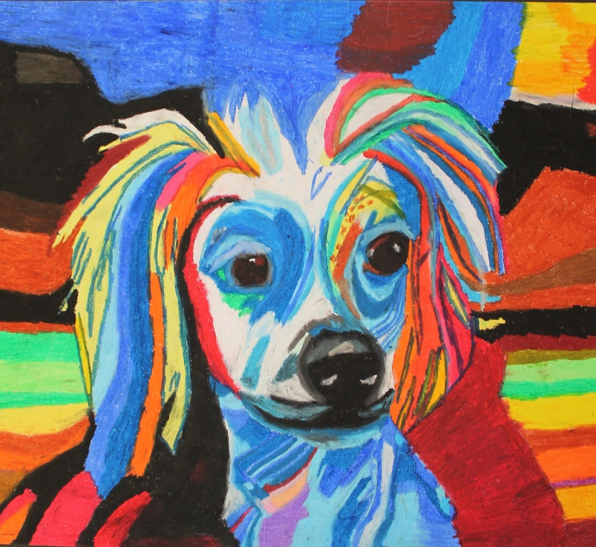
• Students choose one starting point and produce a personal response. • They have 13 school weeks and 3 weeks of holiday to prepare. During this period they should research artists, gather images, take photos, develop and refine ideas and record ideas using a variety of images. • Work during the preparatory period could be in sketchbooks, journals, design sheets, separate studies or in any other appropriate form, including digital media. • Students must make reference to at least two artists, craftspeople, designers and/or photographers. These can be those named in the question they have chosen or other relevant examples they have found themselves. Students must identify and acknowledge sources that are not their own.
GCSE Art, Craft and Design Exam 2026. (40% of final grade) Students were given the paper on the 7th January. It comprises of 7 questions, each with an overarching theme and suggestions of artists linking to this theme. I showed students a presentation giving examples of images relating to each exam question and artists from the exam paper. I have put the presentation on google classroom.

Slide 2
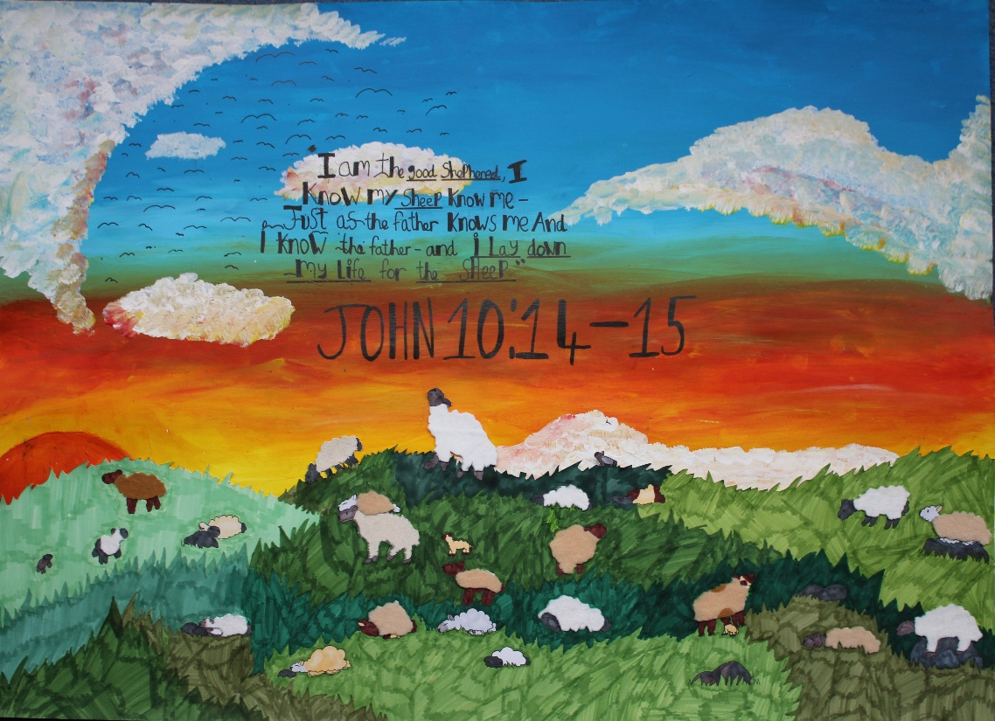
Please talk to your child about which question they want to work on. Once they chose it, they should create their preparatory work. This work should include, but is not limited to, the following suggestions;
Create a mind map about their choice of theme.
Create a mood board about their choice of theme.
Use the analysis help sheet on google classroom to analyse at least two artists who work within the theme they have chosen. (These can be from the exam paper or someone else the student has researched.)
Take photographs linked to their choice of theme.
Draw from these photographs, artist links and mood board.
Inspired by their work so far they need to create initial ideas about what they could produce in their exam. These could be paintings, drawings, sculptures or other art forms.
Refine these ideas to have more developed pieces of work. Aim for three developed ideas.
Their final idea/piece will be created during their 10 hours exam. They will do their exam over two days on either the 27th - 28th April or the 29th - 30th April.

Slide 3
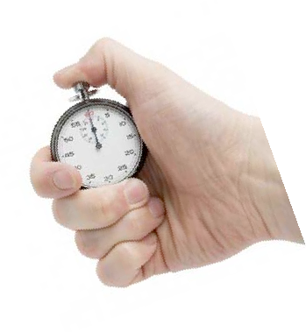
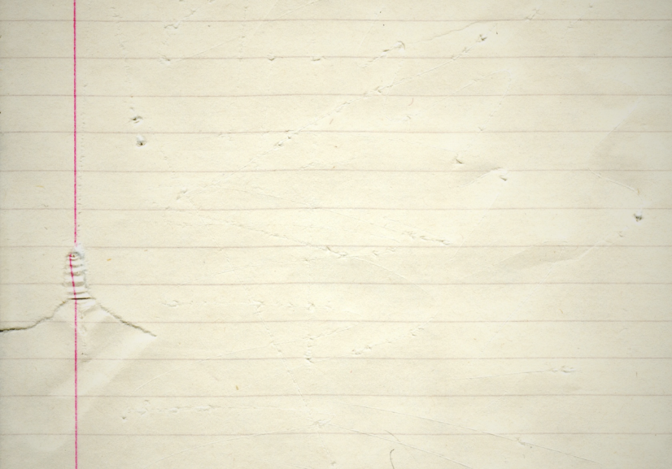
AQA GCSE Art, Craft and Design 2026 – Externally Set Assignment
Counts towards 40% of the final GCSE grade. It is assessed using four assessment objectives. These are the same assessment objectives used to assess the internally set assignments.
AO1 (Develop) -
Find relevant artists to look at
Use this work to inspire mini pieces of work
Make personal comments about this work
Visit museums, galleries, cities, spaces etc to inspire your work
Starting Points
Nature
Contrasts
Time
Books
Interiors
Appearance
Movement
Each Assessment Objective is worth 24 marks. Unit two is marked out of 96 marks.
AO2 (Develop) -
Explore different media in your sketchbook
Use different techniques and processes
Evaluate how successful your experiments have been
AO3 (Record)
Collect and present only relevant imagery
Produce high quality drawings/sketches/ paintings etc
Take your own photos
Annotate your work
After the preparation time you will have your exam. It will be 10 hours over 2 days.
Your exam is on the
27th - 28th April or the 29th - 30th April.
AO4 (Present)
Produce confident and high quality final piece/s
Ensure your work links to your prep work

Slide 4
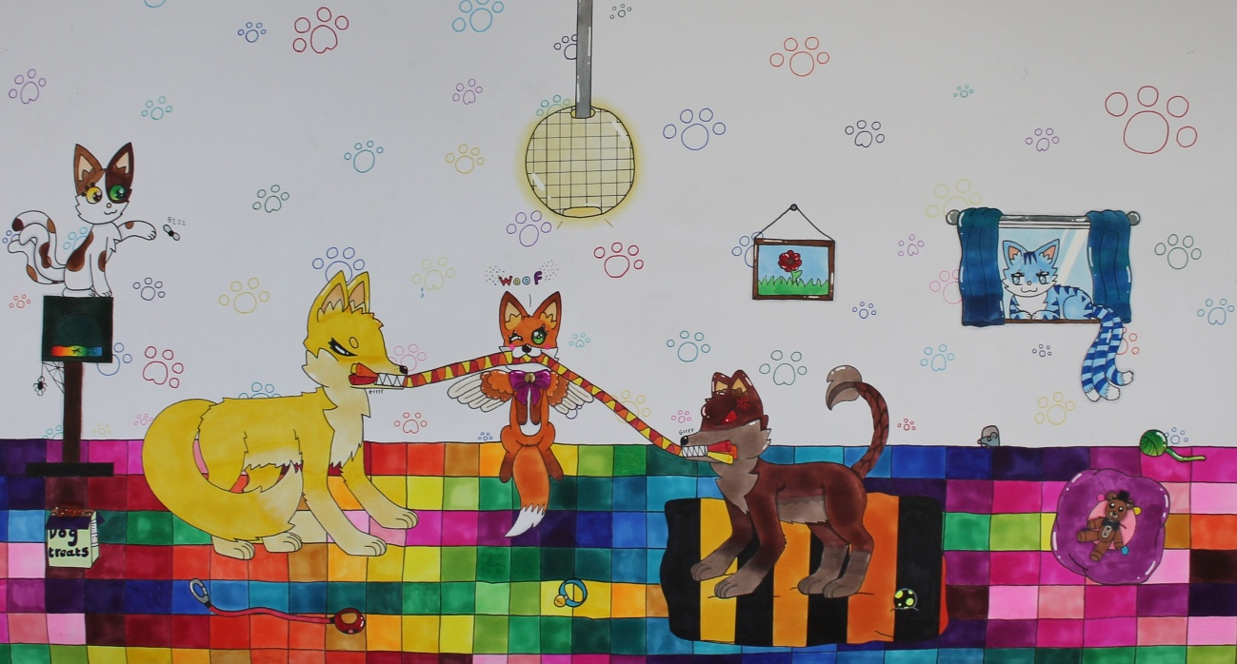
Students can do their preparation work during art lessons, but as we only have two lessons a week they would benefit from doing some work at home if possible.
Some themes lend themselves to doing some work out of school, for example if the student wants to draw or take photos of their family (which could link to themes of time or appearance) or draw or take photos of their bedroom for the interiors theme. They could then work from these photos and drawings at school.
Staff can support students during the preparation time, but we cannot help them during the exam which is completed under exam conditions. It is therefore important that students know exactly what they are doing in their exam, and ideally they will have practiced it on a smaller scale prior to the exam.
There is no written work expected in the 10 hours exam.

Slide 5
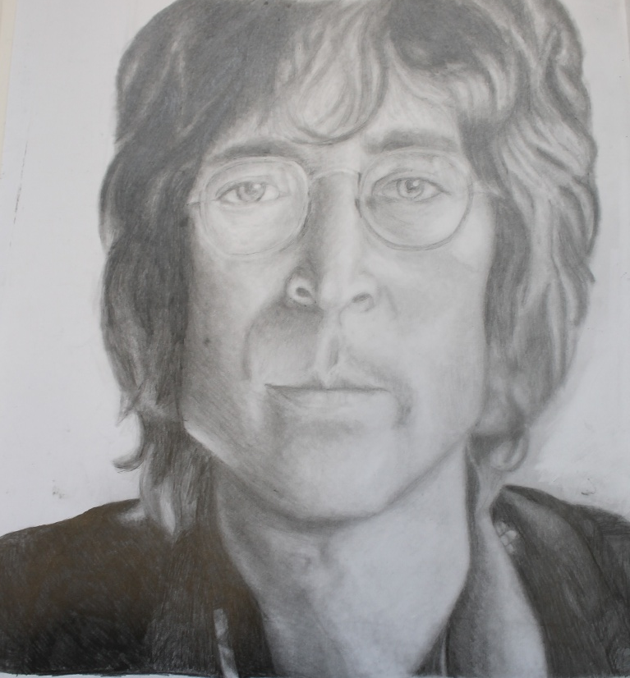
Following the preparatory period, students have 10 hours of supervised time to complete their personal response. The 10 hour exam will take place over two days. Because it is a large group we will split the group in half. The exam will take place on either the 27th - 28th April or the 29th - 30th April.
During the exam students can;
•Refer to preparatory work, but the prep work must not be added to or amended after the start of the exam. • The work produced in the supervised time may take any appropriate form.
Preparatory and supervised work must stay in school at the end of each supervised session and at the conclusion of the 10 hours of supervised time.
The work submitted for this component must be produced unaided.
The content should not be shared with others, either in hard copy or online.

