Slide 1

My Pupil Passport
2026-27
Name:
Tutor Group:

Slide 2
I like to be called…
3 most important things to know about me
(e.g., my triggers or things that help me)
My needs / diagnoses are…
My important people are…
All About Me
My interests are…
Talk to me about…

Slide 3



Things I’m good at:
Things I like and am interested in:
Things that help me to work well:

Slide 4



Things I need help with:
Things I don’t like:
Things that don’t help me to work well:

Slide 5




I communicate using...
My Communication
You can help with my communication by…

Slide 6




My Sensory Preferences
My Sensory Likes | My Sensory Dislikes
You can help me to regulate by…

Slide 7


When I’m stressed I may…
My Feelings
When I’m stressed it helps if I can…
You can help me when I’m stressed by…

Slide 8


My EHCP Targets
EHCP Outcome Target 1 | B / D / S
 | Term 1 | Term 2 | Term 3
How we will achieve this target:
EHCP Outcome Target 2 | B / D / S
 | Term 1 | Term 2 | Term 3
How we will achieve this target:
EHCP Outcome Target 3 | B / D / S
 | Term 1 | Term 2 | Term 3
How we will achieve this target:
B=Beginning, D=Developing, S=Secure
How can school help you to achieve your targets?

Slide 9
My EHCP Targets
EHCP Outcome Target 1 | B / D / S
 | Term 4 | Term 5 | Term 6
How we will achieve this target:
EHCP Outcome Target 2 | B / D / S
 | Term 4 | Term 5 | Term 6
How we will achieve this target:
EHCP Outcome Target 3 | B / D / S
 | Term 4 | Term 5 | Term 6
How we will achieve this target:
B=Beginning, D=Developing, S=Secure
How can school help you to achieve your targets?

Slide 10

My Target Progress Diary
Please complete with the support of your LSA
Date | LSA Initials | How do you feel you are getting on with your targets? | What support can we offer you to help you achieve your targets?

Slide 11



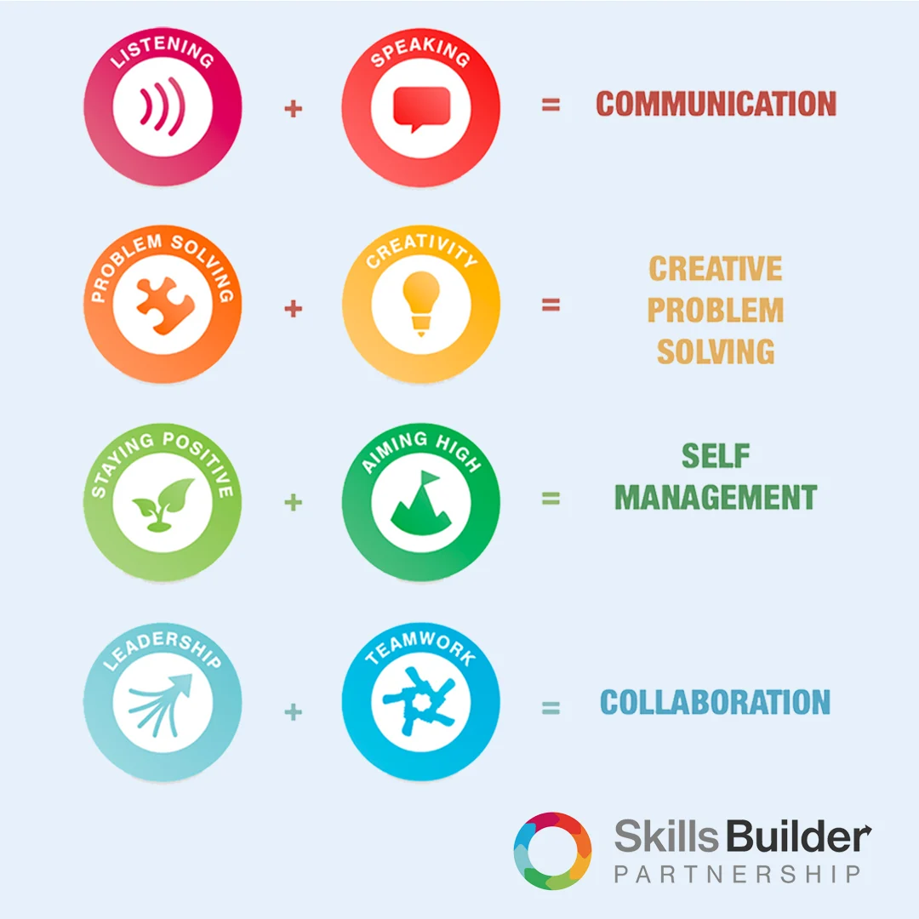
My Own Target
Think of your own target you would like school to help you achieve this year
Essential Skills

Slide 12

Essential Skills
1 | 2 | 3 | 4 | 5 | 6 | 7 | 8 | 9 | 10 | 11 | 12 | 13 | 14 | 15
Dependent |  |  | Lots of help |  |  | Some help |  |  | A little help |  |  | Independent
Essential Skill | Term 1 |  | Term 2 |  | Term 3
 | Step (1-15) | B/D/S | Step (1-15) | B/D/S | Step (1-15) | B/D/S
Listening
Speaking
Solving Problems
Creativity
Staying Positive
Aiming High
Leadership
Teamwork
Essential Skill | Term 1 |  | Term 2 |  | Term 3
P4A | Step (1-10) | B/D/S | Step (1-10) | B/D/S | Step (1-10) | B/D/S
Physical & Emotional Health
Employment & education
Independence
Friends, relationships and community cohesion

