Slide 1
Homework Project
Your task is to complete a project on the topic of ‘Performing Arts’. Choose one or more of the tasks on the other side of this sheet and complete it to the best of your ability. The tasks are divided into the following categories:
Enjoy - Aspire - Challenge
These three categories are the levels of difficulty of each task. So, choose a task that suits your ability but make sure it challenges your skills.
Due date: 8th July.
Your tutor will mark your project and support you along the way. A member of the leadership team will also view your project. There will be house points available for effort and achievement.

Slide 2
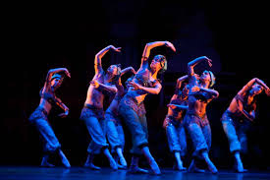
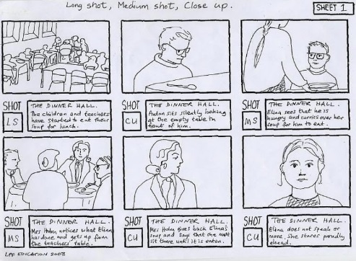
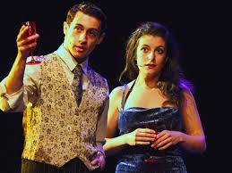
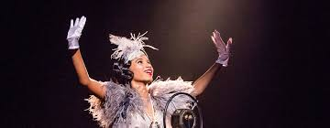
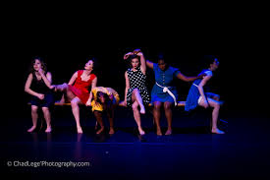
Blue - Enjoy
Design a poster that advertises a new musical which stars you!!:
Make sure it is colourful and eye catching.
The title could have something to do with the school.
Yellow - Aspire
Red - Challenge
Create a silent movie storyboard:
Include pictures and descriptions
Make sure it has a clear:
Beginning
Middle
End
Make a program about a show you have seen.
Include pictures and information about the performance as well as time and dates.
Write your own play script:
You could include your teachers and class mates.
Write you own song/rap. You could even perform it and film it.
Write a character study on you favourite film/play/musical.
You need to:
Include pictures.
Say what that actor has done before.
Create a definition poster using words you have learnt from performing arts.
Collaboration
Solo
Monologue
Exaggerate
Body language
Tone of voice
Levels
Ect
Choreograph your own dance routine:
You could include you friends or even draw pictures of the moves you would do to a song.

